Slide 1



IAUP REGIONAL MEETING IN EGYPT
THE GREAT RESIGNATION:
A REGIONAL CHALLENGE
OR GLOBAL REALITY?
DR. MD. SABUR KHAN
President, AUAP
Founder & Chairman
Daffodil International University, Bangladesh

Slide 2

Understanding the Great Resignation and its impact on the workforce
Employees across multiple sectors came to the realization that they weren't happy with their jobs during the pandemic. People weren't satisfied with their work environment, the industry they were in or their work-life balance and left their jobs.
Anthony Klotz coined the term the Great Resignation.

Slide 3
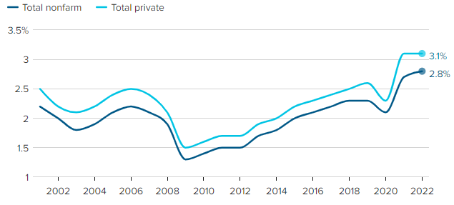
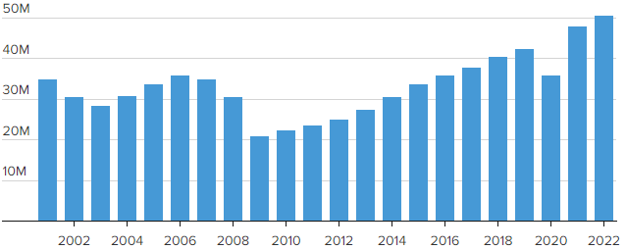
Great Resignation: US case
Average quit rates in the U.S. continued at historic highs
in 2022
A record 50.5 million people in the U.S. quit their jobs
in 2022
https://www.cnbc.com/2023/02/01/why-2022-was-the-real-year-of-the-great-resignation.html#:~:text=About%2050.5%20million%20people%20quit,to%20leave%20the%20workforce%20altogether.
Source: U.S. Bureau of Labor Statistics' Job Openings and Labor Turnover Survey via FRED

Slide 4
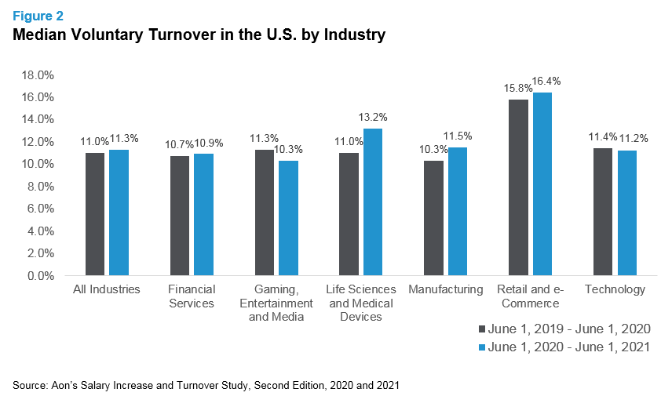
Great Resignation: US case
Source: Aon’s Salary Increase and Turnover Study, Second Edition, 2020 and 2021

Slide 5
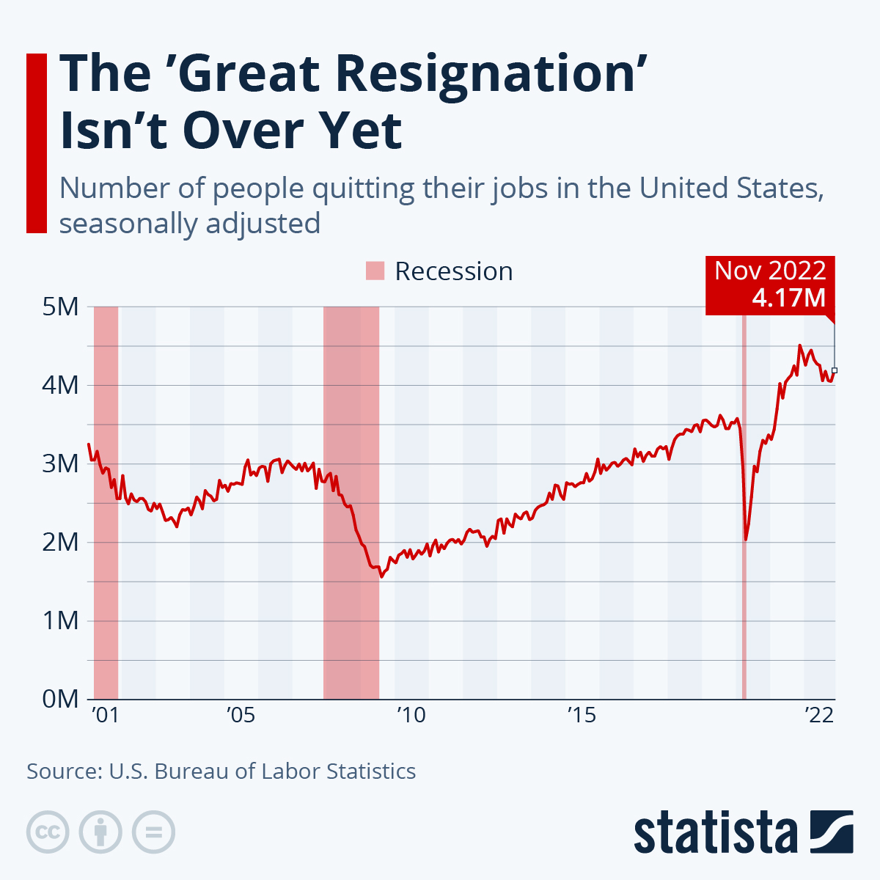
the number of Americans leaving their jobs is still very high at 4.06 million, though, while the number of job openings jumped back up to 10.72 million in September.
Resignation rates are highest among mid-career employees
Resignation rates are highest in the technology and healthcare industries

Slide 6
Great Resignation statistics
One in five nonretired adults left their job by choice in 2021, according to a Pew Research survey.
41% of the total global workforce is leaving their employer in the next year, according to a Microsoft report published in March 2021.
71% of people who responded to a LinkedIn survey said being stuck at home during the pandemic was a root cause for them to reconsider their current state of employment.
39% percent of respondents to a PagerDuty report identified an increase in employee turnover in technical teams over the past 12 months.
20% of employees worldwide are actually engaged by their work, according to the Gallup State of the Global Workplace 2021 report. The lack of engagement means it's more likely that employees will look for other more fulfilling and engaging employment.
Source: https://www.techtarget.com/whatis/feature/The-Great-Resignation-Everything-you-need-to know#:~:text=Employees%20across%20multiple%20sectors%20came,the%20term%20the%20Great%20Resignation.

Slide 7
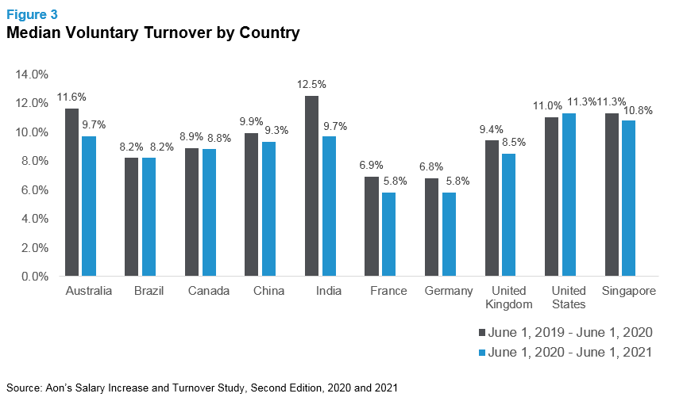
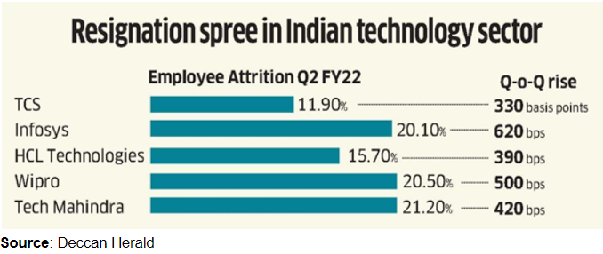
Global Perspectives
Sources:
Aon’s Salary Increase and Turnover Study, Second Edition, 2020 and 2021
Deccan Herald

Slide 8
Global Perspectives
AUSTRALIA | CHINA | EUROPE
Australia’s government said last month that 1 million workers began new roles in the three months to November 2021. The rate of job switching is almost 10% above the pre-pandemic average. | In February 2020, soon after the first coronavirus lockdowns were imposed in China, the nation’s job market shrank by about 30 per cent, but demand for live-streamers actually grew by 132.55 per cent, according to a Zhaopin report. | In the wake of lockdown, Germany had the most COVID-related resignations (6%), followed by the UK (4.7%), the Netherlands (2.9%) and France (2.3%). Belgium was the most stable (1.9%) in terms of resignations.

Slide 9

For Bangladesh Market
Great Resignation may not be as relevant to Bangladesh as perceived by some. Hence, the question of readiness does not come from a mindset perspective.

Slide 10
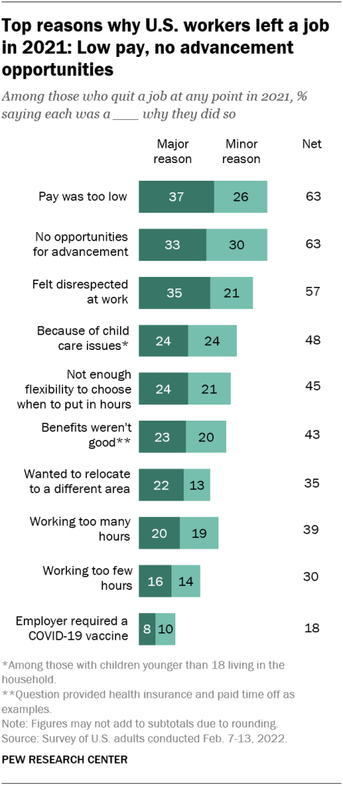
Key factors
Majorities of workers who quit a job in 2021 say low pay (63%), no opportunities for advancement (63%) and feeling disrespected at work (57%) were reasons why they quit, according to the Feb. 7-13 survey. At least a third say each of these were major reasons why they left.

Slide 11
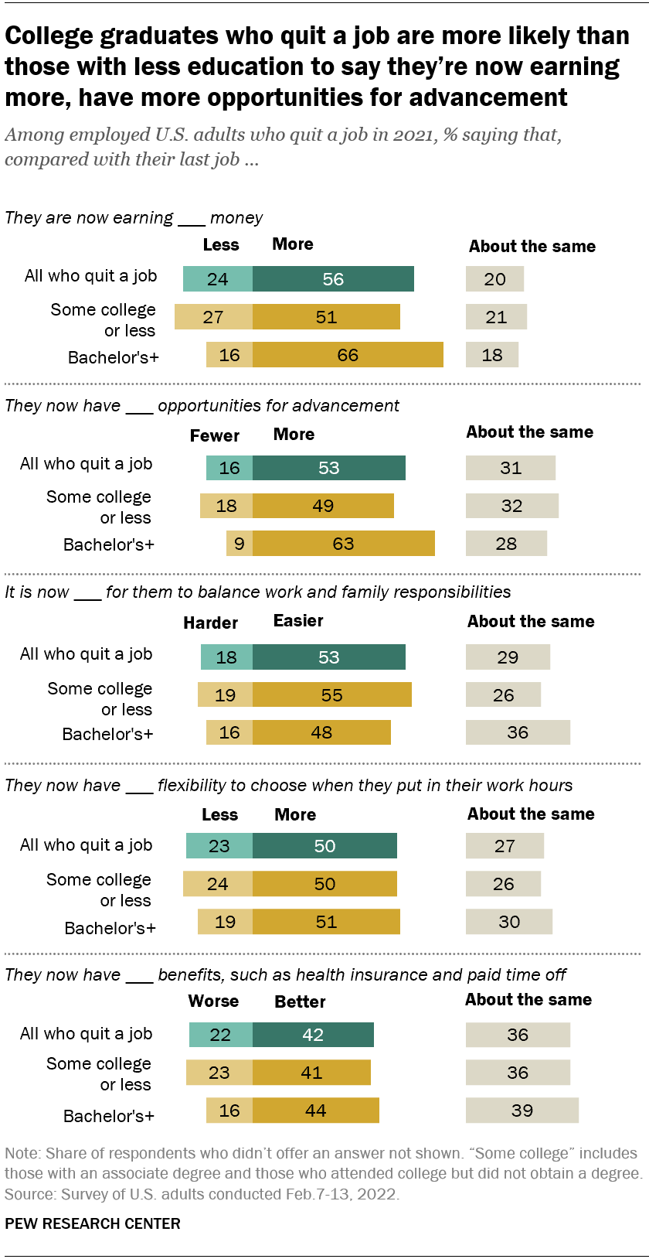
Key factors
Graduates are more likely than those with less education to say that compared with their last job, they are now earning more (66% vs. 51%) and have more opportunities for advancement (63% vs. 49%). In turn, those with less education are more likely than college graduates to say they are earning less in their current job (27% vs. 16%) and that they have fewer opportunities for advancement (18% vs. 9%).
Source: Survey of U.S. adults conducted Feb 7-13, 2022

Slide 12
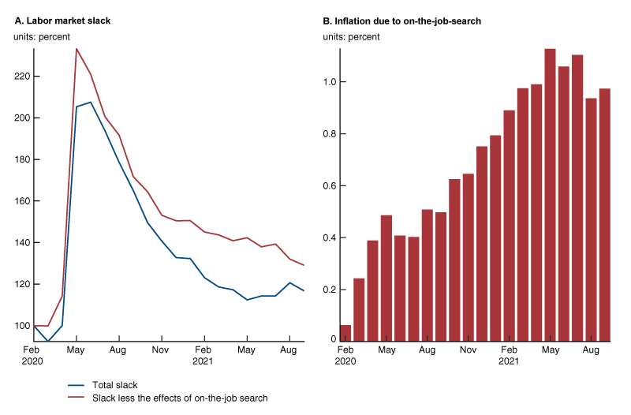
The Effects of the
“Great Resignation”
Source: Faccini, R., & Melosi, L. (2021). Bad jobs and low inflation.

Slide 13

The great resignation
Foster a positive and equitable work environment
Support employees’ career advancement
Compensate workers generously and fairly
Prioritize employees’ well-being
Provide workplace flexibility
Promote open communication

Slide 14
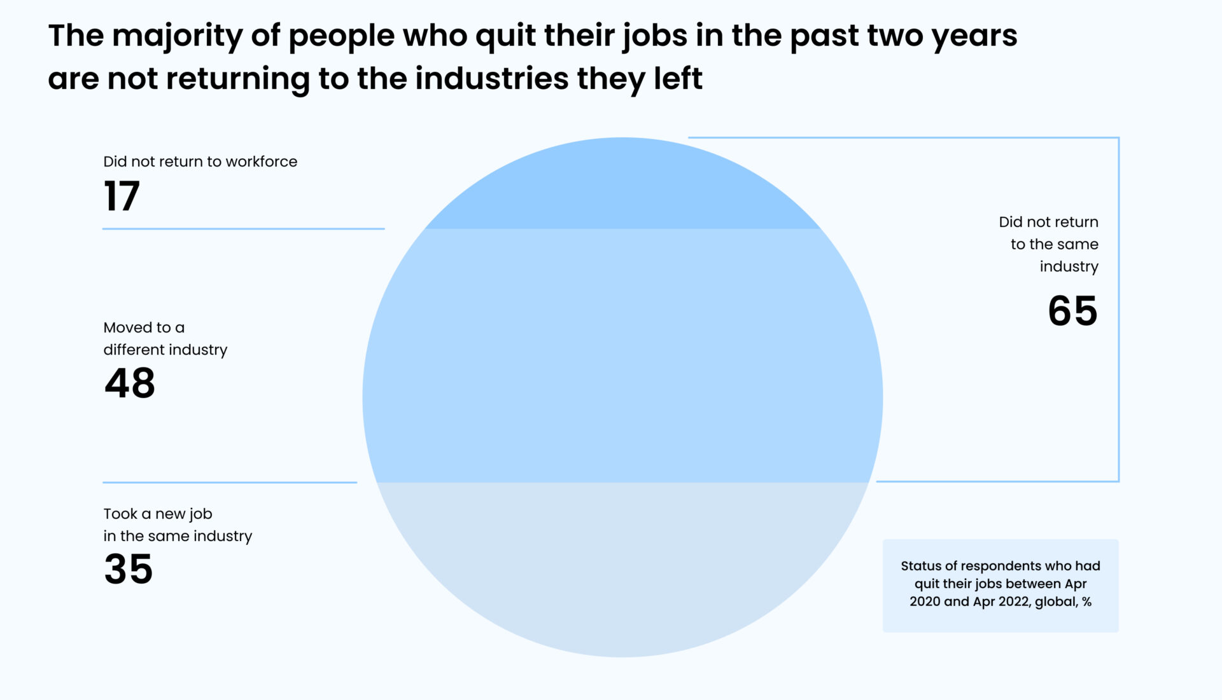
FUTURE outlook: great resignation
Source: https://resources.ovice.in/blog/great-resignation-trends/

Slide 15

FUTURE outlook: great resignation
Listen to the employees who stay to have fewer
of those who leave.
Personalize the way you pursue employees.
Follow market trends and test new technologies.
Use technology to improve the employee experience.

Slide 16
The great resignation in higher education
The "Great Resignation" is a term used to describe the phenomenon of high numbers of employees resigning from their jobs amidst the COVID-19 pandemic. The pandemic has caused many people to reevaluate their priorities and work-life balance, leading them to seek out new opportunities or leave their current jobs altogether. The higher education sector, specifically, may be impacted by the Great Resignation in a number of ways.
Firstly, the higher education sector may see an increase in job openings as more employees resign. This may create opportunities for those looking to enter the sector or for existing employees to advance in their careers.
On the other hand, higher education institutions may also experience challenges in retaining employees. As more people leave their jobs, institutions may struggle to maintain a stable workforce and may face increased recruitment costs.

Slide 17
DIU Initiatives during pandemic:

Slide 18



Digital Steps for Sustainability
SmartEdu
GoEdu
Blended Learning Center (BLC)

Slide 19


Slide 20


Slide 21


Slide 22


Slide 23
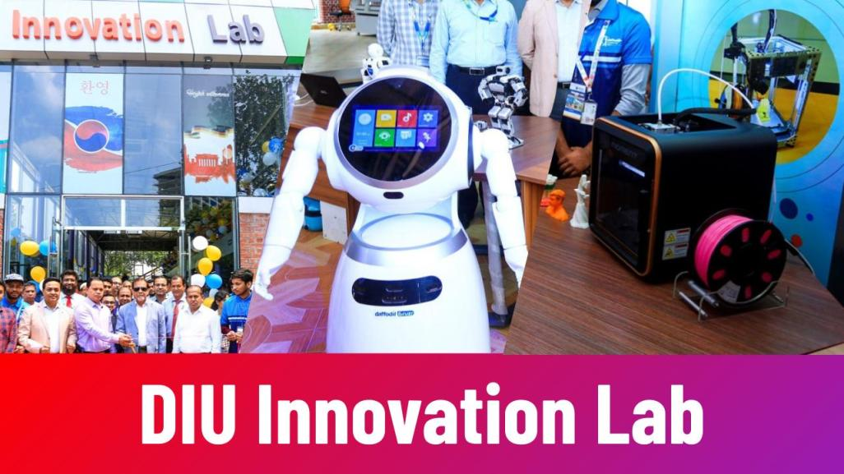

Slide 24
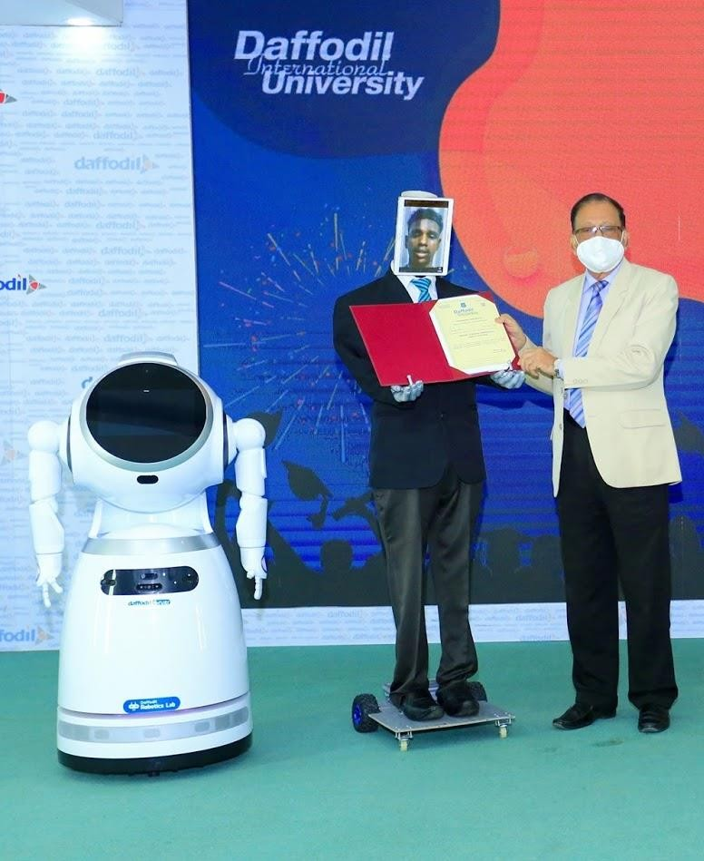
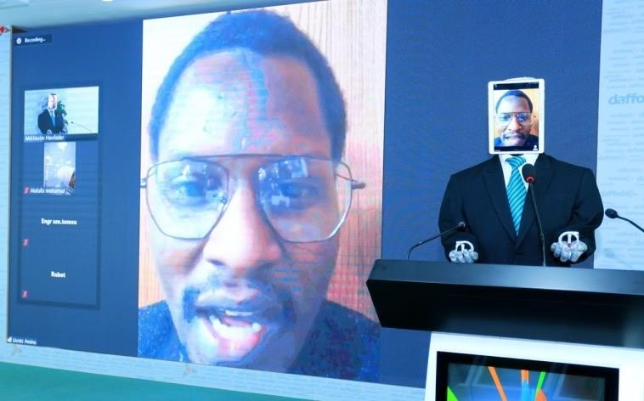


Virtual
Farewell Ceremony

Slide 25

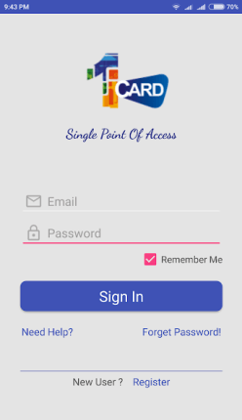
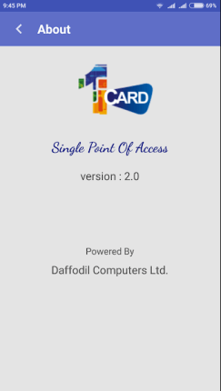
1-Card solution provides unified permissions, credentials, payments, and security across campus.

Slide 26
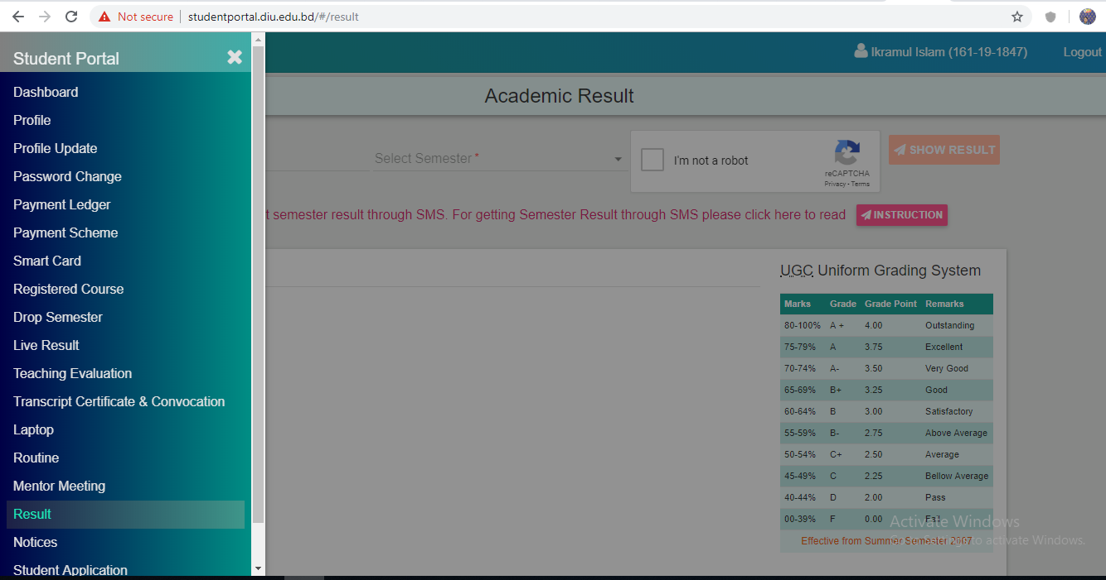
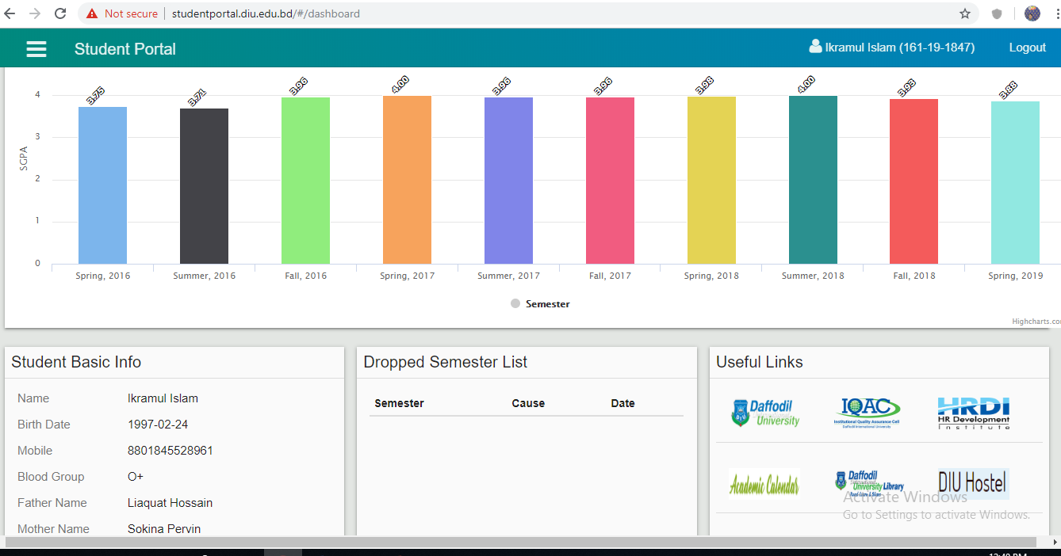
Student Portal/Dashboard
Student Portal/Dashboard
DIU has established unique ‘Student Portal, from where students can create profile, see result, payment ledger and scheme, information on transcript/certificate, routine, mentor meeting etc.
http://studentportal.diu.edu.bd/#/login

Slide 27
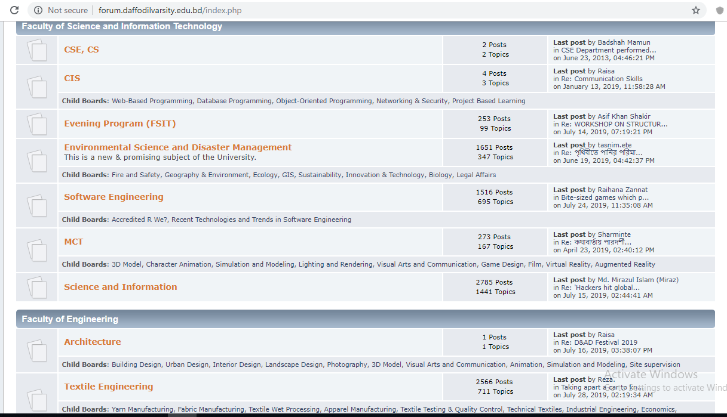
DIU Forum

Slide 28
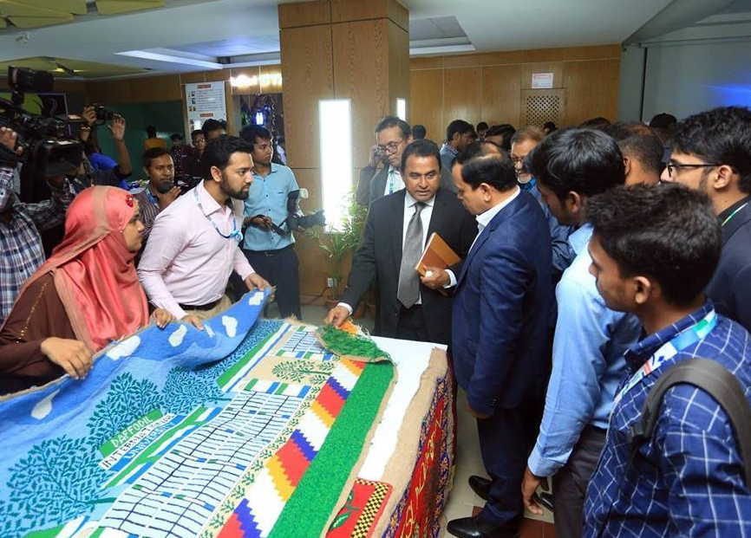
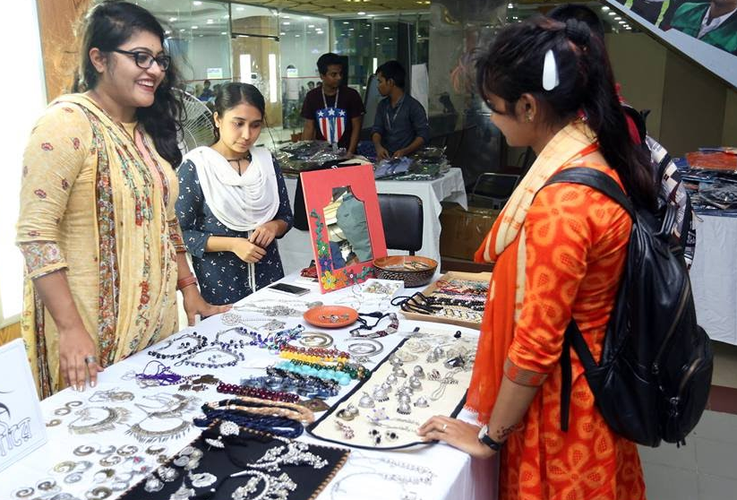


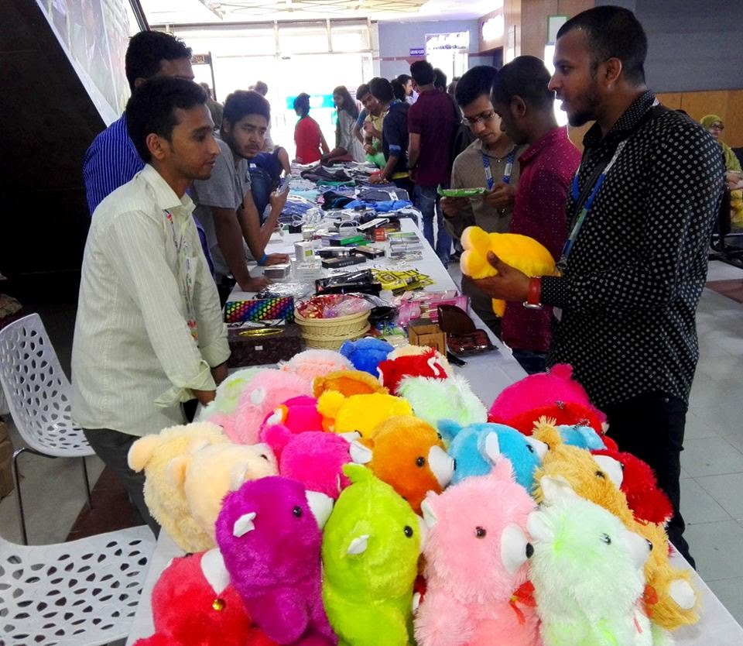

Slide 29


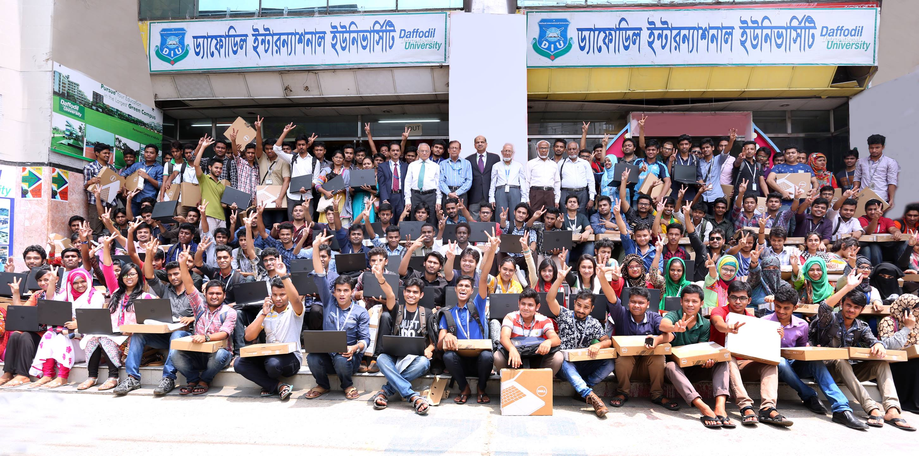
ONE STUDENT ONE LAPTOP

Slide 30


Let us
Upgrade our
Higher Education Operation Virtually
for a Sustainable Future
TOGETHER!

Slide 31


Slide 32

Who Will Take The
Take the Responsibility to Implement the Ideas…
Image Source: http://job-envie.com/nl/faq-2/

Slide 33


